Slide 1
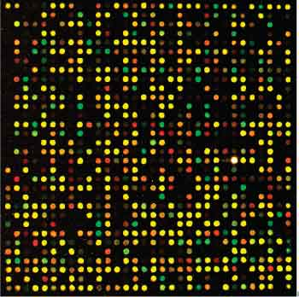
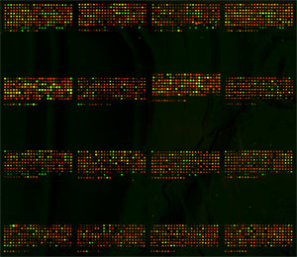
Microarray Analysis Flow Chart
cDNA synthesis and Cy3/5 labeling
Hybridize to Microarray
RNA extraction
Dry & Scan
Feature Extraction
Data Transformations & Adjustments
Normalization
Data Filtering
Statistical Tests
Post-hoc Tests
Visualization

Slide 2
High Quality RNA is Essential
RNA extraction
Bioanalyzer results for zebrafish total RNA extractions
The two peaks represent the 18S and 28S rRNA – these should be abundant and not degraded

Slide 3
Lab Work to Raw Data
cDNA synthesis and Cy3/5 labeling
Hybridize to Microarray
RNA extraction
Dry & Scan
Feature Extraction
Vendor Software
Spot finding
Outlier detection
Measure feature intensity (Cy3 and/or Cy5)
Background Subtraction or Detrending
Commercial microarrays make extensive use of internal control probes

Slide 4
Feature Extraction

Slide 5
Feature Extraction

Slide 6
Feature Extraction

Slide 7
Normalization
cDNA synthesis and Cy3/5 labeling
Hybridize to Microarray
RNA extraction
Dry & Scan
Feature Extraction
Normalization

Slide 8
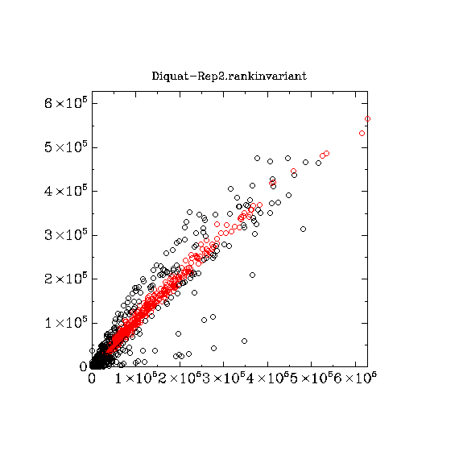

Example #1 – Rank Invariant Probes
An oxidative stress experiment in zebrafish embryos with exposure to diquot, sulforophane (SFN), tBHQ, and tBOOH
DMSO controls (also labeled as UT or UTD)
20 microarrays total – single dye (Cy3) hybridization!
Which microarrays had the highest and lowest Cy3 loadings?
Which microarray required the most normalization?

Slide 9
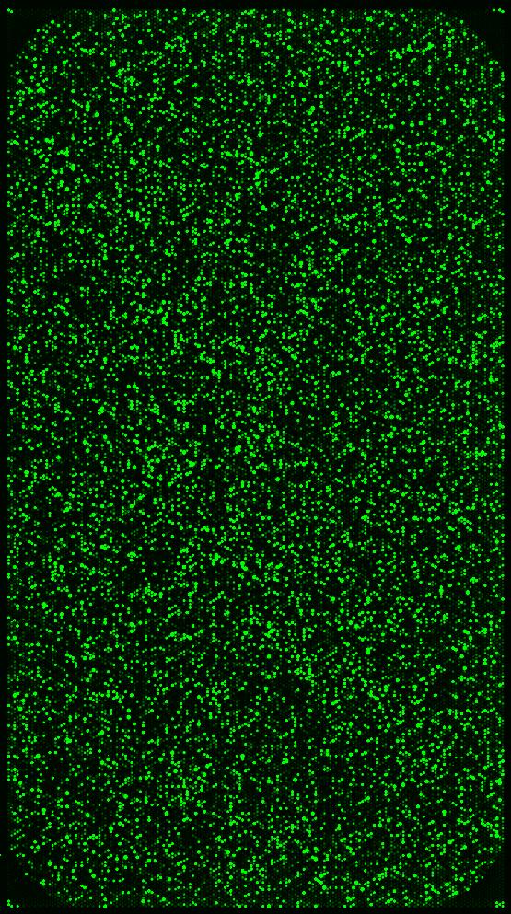
Example #1 – Rank Invariant Probes
This is a single dye experiment!
DMSO-Rep1
SFN-Rep1
Cy3
Cy3
hyb #1
hyb #1
etc…
hyb #2
hyb #2
Cy3
Cy3
Diquat-Rep1
tBHQ-Rep1

Slide 10
Data Filtering
cDNA synthesis and Cy3/5 labeling
Hybridize to Microarray
RNA extraction
Dry & Scan
Feature Extraction
Normalization
Data Filtering

Slide 11
Example #2 – Filtering
Zebrafish embryos exposed to DMSO, tBHQ, or TCDD
Two dye hybridization of all samples (Cy5 - red) against a reference RNA sample (Cy3 - green)
EXCEL is normalized data for 3 samples
what is the most highly expressed gene for the tBHQ, TCDD, and DMSO samples?
what is the most highly expressed gene in the Universal Reference samples?
which genes are saturated in which samples?
are there non-uniform features?
what percentage of the microarray probes are covered by the Universal Reference?

Slide 12
Example #2 – Filtering
This is a two-dye experiment!
DMSO-Rep1
tBHQ-Rep1
TCDD-Rep1
Cy5
Cy5
Cy5
etc…
Cy3
Cy3
Cy3
Univ Ref
Univ Ref
Univ Ref

Slide 13
Microarray Analysis Flow Chart
cDNA synthesis and Cy3/5 labeling
Hybridize to Microarray
RNA extraction
Dry & Scan
Feature Extraction
Data Transformations & Adjustments
Normalization
Data Filtering
Statistical Tests
Post-hoc Tests
Visualization

Slide 14
Example #3 – Statistical Analysis
Perform a complete analysis of microarray data
Introduction to MeV software
Log transform the data
Median Centre the data
Adjust visualization of the data
Perform ANOVA
Perform Cluster Analysis
A oxidative stress experiment involving pools of 30 zebrafish embryos exposed to tBHQ, TCDD, Diquat, SNF, or a DMSO control
Two or Three replicates for each time point
Single channel (Cy3) use of a Agilent zebrafish microarray
Determine the patterns of significant changes in gene expression during exposure to oxidative stress

Slide 15
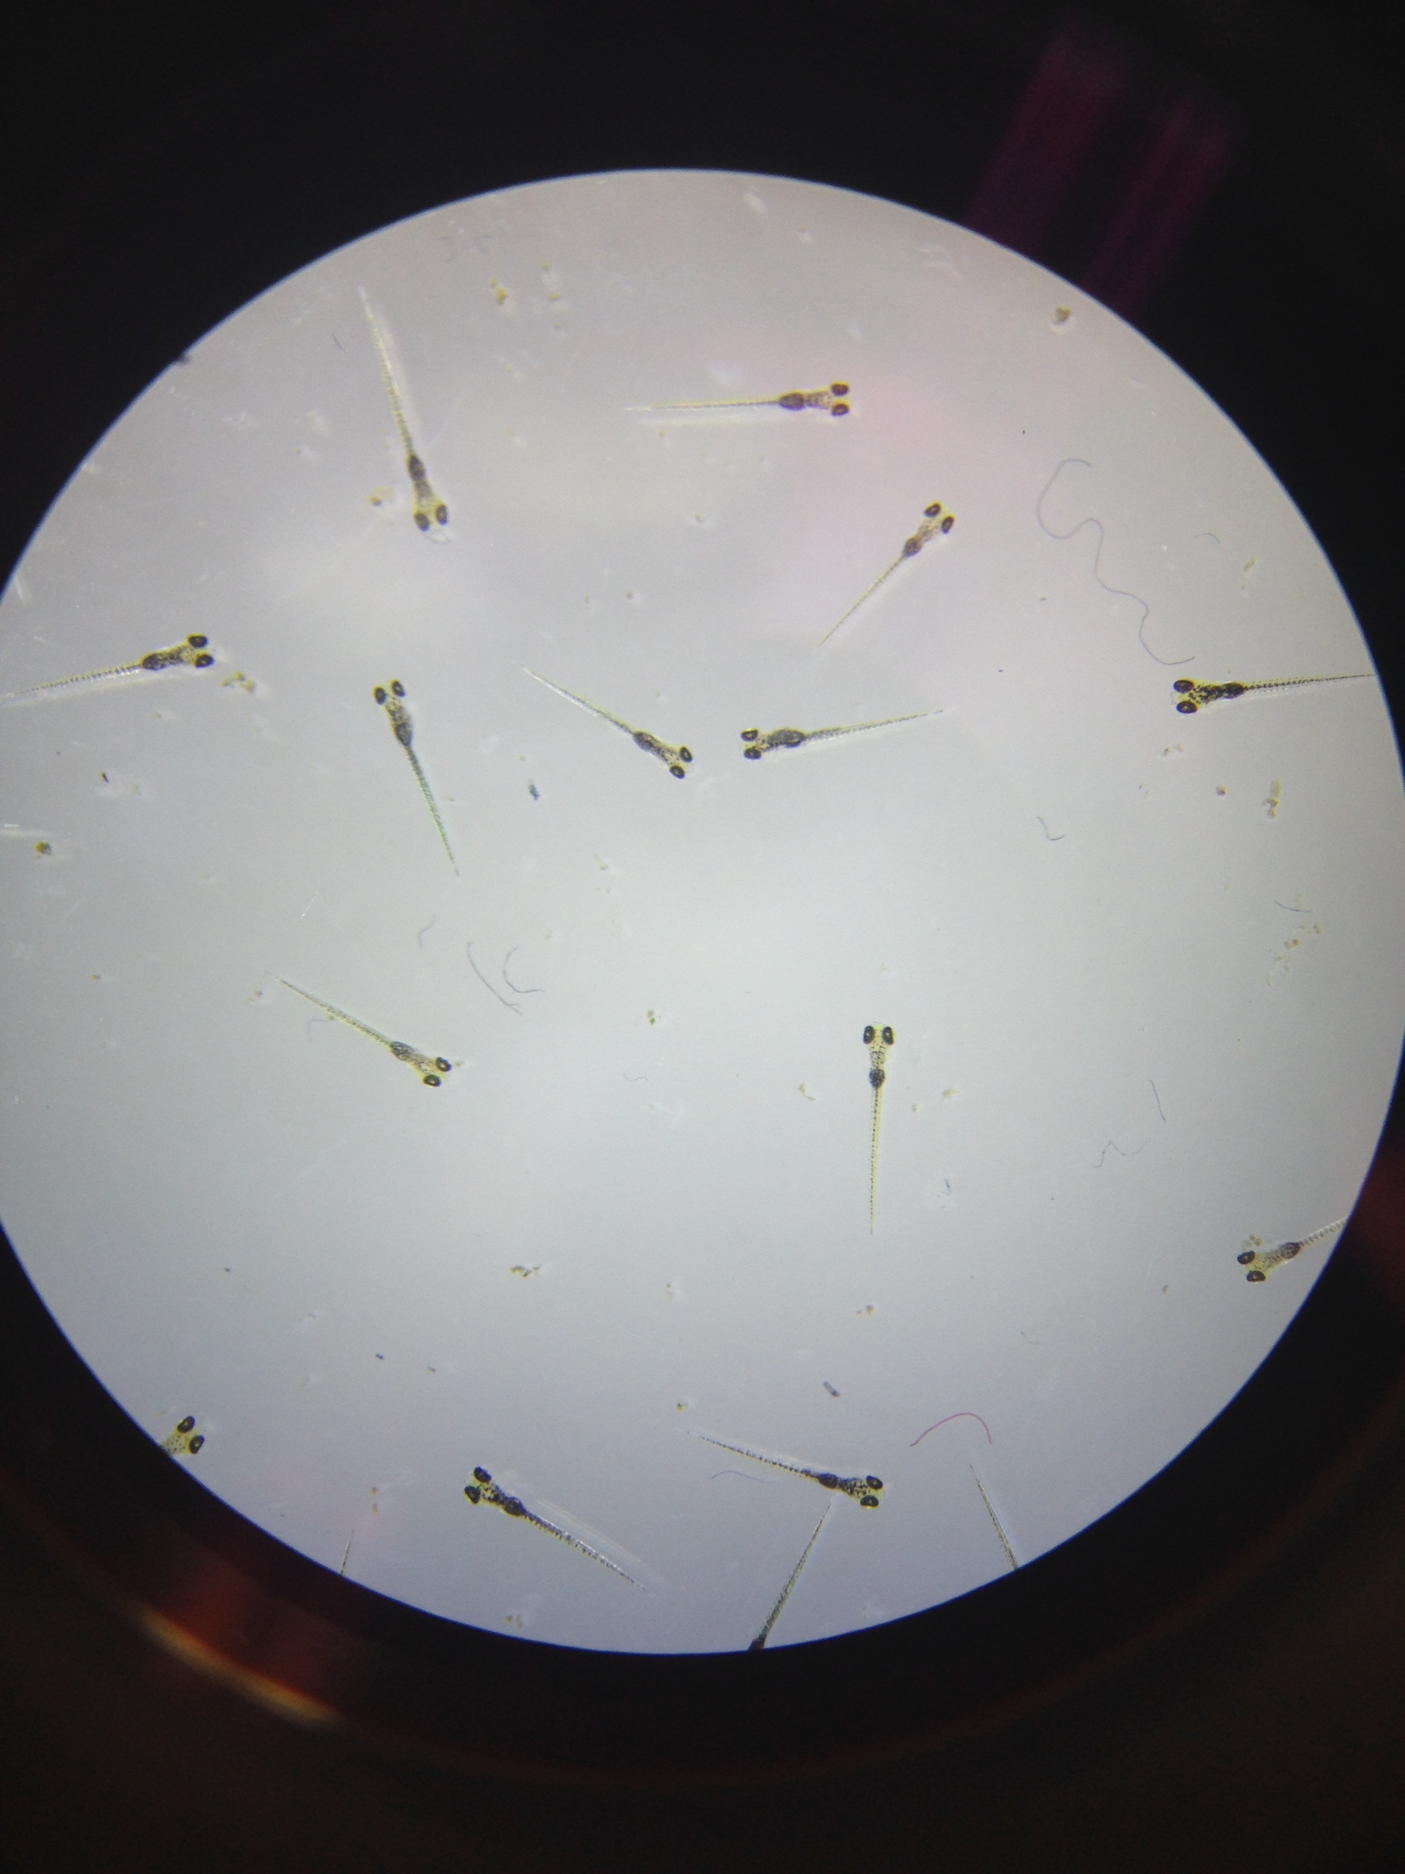
Example #3 – Statistical Analysis
DMSO
5 treatments x triplication = 15 samples
1 sample discarded due to a dust fragment on the microarray
30 embryos
30 embryos
30 embryos
SFN
30 embryos
30 embryos
30 embryos
Diquat
30 embryos
30 embryos
30 embryos
TCDD
30 embryos
30 embryos
tBHQ
30 embryos
30 embryos
30 embryos

Slide 16
Example #3 – Statistical Analysis
Perform a complete analysis of microarray data
Introduction to MeV software
Log transform the data
Median Centre the data
Adjust visualization of the data
Perform ANOVA
Perform Post-Hoc analysis (Rank Product)
Generate a Heat Map, Venn Diagrams, Principal Components Analysis
Distributions examined: F-distribution, de novo permutated distribution
Type I error control: p<0.05 versus p<0.01
Type II error control: nothing, Adj. Bonferroni, 1% or 5% FDR correction
Type I error = false positives (aka false discovery)
Type II error = false negatives
In the adjusted Bonferroni correction, the t-values for all the genes are ranked in descending order. For the gene with the highest t-value, the critical p-value becomes (alpha / n), where n is the total number of genes; for the gene with the second-highest t-value, the critical p-value will be (alpha/ n-1), and so on.

